Slide 1

The University
Mental Health Charter
Flourishing Futures Conference
Leigh Spanner, Sector Improvement Lead
Student Minds
@StudentMindsOrg
#UniMentalHealthCharter
Notes:
Download the Charter here: https://www.studentminds.org.uk/charter.html

Slide 2

#UniMentalHealthCharter
Who are Student Minds?

Slide 3

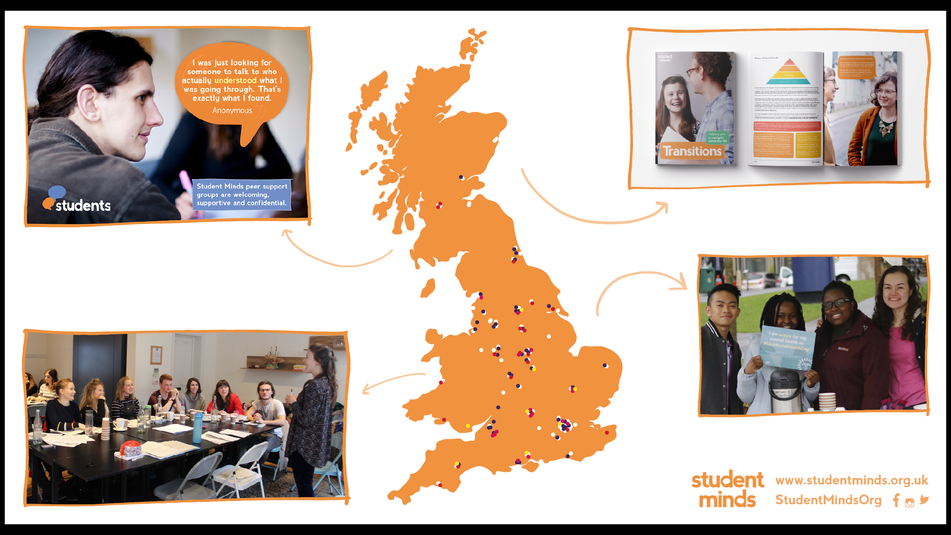

#UniMentalHealthCharter
Student Minds
The UK’s Student Mental Health Charity
Peer support
Staff training
Student-led campaign groups
Developing students’ unions, universities and accommodation providers
Research & policy
Notes:
Find out more about Student Minds here: https://www.studentminds.org.uk/about.html

Slide 4
What is mental health?
#UniMentalHealthCharter
Mental health refers to a full spectrum of experience ranging from good mental health to mental illness
Good mental health = feeling good, responding appropriately, positively contributing to the community and the absence of illness
Poor mental health or mental health problems = individuals experience levels of emotional and/or psychological distress beyond their ability to effectively manage
Notes:
House of Commons Library (2019). Support for students with mental health issues in higher education in England. London: UK Commons Library, pp.1–16.
Hughes, G., Panjwani, M., Tulcidas, P. & Byrom, N. (2018). Student mental health: The role and responsibilities of academics. Oxford: Student Minds.
Officeforstudents.org.uk. (2019). Innovation, partnership and data can help improve student mental health in new £14m drive – Office for Students. [online] Available at: https://www.officeforstudents.org.uk/news–blog–and– events/press–and–media/innovation–partnership–and–data– can–help–improve–student–mental–health–in–new–14m– drive/ [Accessed 3/9/19].
Office for National Statistics. (2018). Estimating suicide among higher education students, England and Wales: Experimental Statistics. London: ONS https://www.ons.gov.uk/ peoplepopulationandcommunity/birthsdeathsand marriages/deaths/articles/estimatingsuicideamonghigher educationstudentsenglandandwalesexperimental statistics/2018–06–25 [Accessed 4/9/19]
Morrish, Liz. (2019). Pressure Vessels: The epidemic of poor mental health among higher education staff. London: HEPI. https://www.hepi.ac.uk/wp–content/uploads/2019/05/ HEPI–Pressure–Vessels–Occasional–Paper–20.pdf
Kinman, Gail. (1998) Pressure Points: A survey into the causes and consequences of occupational stress in UK academic and related staff. London: Association of University Teachers. https://www.ucu.org.uk/media/50/ Pressure–Points–––Occupational–Stress–in–UK– Universities–.pdf/pdf/pressurepoints.pdf

Slide 5
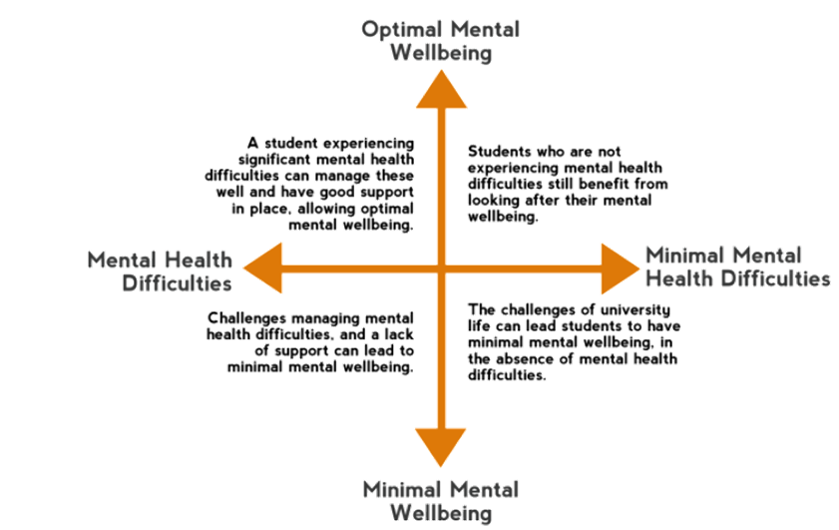
What is mental health?
#UniMentalHealthCharter
Notes:
House of Commons Library (2019). Support for students with mental health issues in higher education in England. London: UK Commons Library, pp.1–16.
Hughes, G., Panjwani, M., Tulcidas, P. & Byrom, N. (2018). Student mental health: The role and responsibilities of academics. Oxford: Student Minds.
Officeforstudents.org.uk. (2019). Innovation, partnership and data can help improve student mental health in new £14m drive – Office for Students. [online] Available at: https://www.officeforstudents.org.uk/news–blog–and– events/press–and–media/innovation–partnership–and–data– can–help–improve–student–mental–health–in–new–14m– drive/ [Accessed 3/9/19].
Office for National Statistics. (2018). Estimating suicide among higher education students, England and Wales: Experimental Statistics. London: ONS https://www.ons.gov.uk/ peoplepopulationandcommunity/birthsdeathsand marriages/deaths/articles/estimatingsuicideamonghigher educationstudentsenglandandwalesexperimental statistics/2018–06–25 [Accessed 4/9/19]
Morrish, Liz. (2019). Pressure Vessels: The epidemic of poor mental health among higher education staff. London: HEPI. https://www.hepi.ac.uk/wp–content/uploads/2019/05/ HEPI–Pressure–Vessels–Occasional–Paper–20.pdf
Kinman, Gail. (1998) Pressure Points: A survey into the causes and consequences of occupational stress in UK academic and related staff. London: Association of University Teachers. https://www.ucu.org.uk/media/50/ Pressure–Points–––Occupational–Stress–in–UK– Universities–.pdf/pdf/pressurepoints.pdf

Slide 6
#UniMentalHealthCharter
Why a Charter?

Slide 7
Why a Charter?
#UniMentalHealthCharter
The number of students declaring a pre–existing mental illness to their university has more than doubled since 2014/15¹
Increasing numbers of students experiencing suicidal ideation, self–harm and episodes of psychosis ²
Students experiencing mental illness are more likely to withdraw from university, to underperform and are less likely to secure higher level employment or go on to postgraduate study ³
In 2017/18, 95 students took their own lives ⁴
Significant rises in the number of staff accessing counselling and occupational health services ^{5,6}
Notes:
House of Commons Library (2019). Support for students with mental health issues in higher education in England. London: UK Commons Library, pp.1–16.
Hughes, G., Panjwani, M., Tulcidas, P. & Byrom, N. (2018). Student mental health: The role and responsibilities of academics. Oxford: Student Minds.
Officeforstudents.org.uk. (2019). Innovation, partnership and data can help improve student mental health in new £14m drive – Office for Students. [online] Available at: https://www.officeforstudents.org.uk/news–blog–and– events/press–and–media/innovation–partnership–and–data– can–help–improve–student–mental–health–in–new–14m– drive/ [Accessed 3/9/19].
Office for National Statistics. (2018). Estimating suicide among higher education students, England and Wales: Experimental Statistics. London: ONS https://www.ons.gov.uk/ peoplepopulationandcommunity/birthsdeathsand marriages/deaths/articles/estimatingsuicideamonghigher educationstudentsenglandandwalesexperimental statistics/2018–06–25 [Accessed 4/9/19]
Morrish, Liz. (2019). Pressure Vessels: The epidemic of poor mental health among higher education staff. London: HEPI. https://www.hepi.ac.uk/wp–content/uploads/2019/05/ HEPI–Pressure–Vessels–Occasional–Paper–20.pdf
Kinman, Gail. (1998) Pressure Points: A survey into the causes and consequences of occupational stress in UK academic and related staff. London: Association of University Teachers. https://www.ucu.org.uk/media/50/ Pressure–Points–––Occupational–Stress–in–UK– Universities–.pdf/pdf/pressurepoints.pdf

Slide 8
What can we do?
#UniMentalHealthCharter
Understandably, much of the focus in national discussions has been on avoiding and responding to mental illness
Our view is that the absence of illness, while important, is not enough
Universities can be places that are good for the mental health of our communities

Slide 9
Our vision
#UniMentalHealthCharter
Our vision is for all universities to adopt a whole–university approach to mental health, and become places that promote the mental health and wellbeing of all members of the university community.
We will achieve this through:
An evidence-informed framework to provide a reference point for universities to adopt a whole–university approach to mental health
A programme to support universities to share practice and improve their approach
A voluntary accreditation to encourage ongoing improvement by recognising and building an evidence base of excellent practice

Slide 10
#UniMentalHealthCharter
Introducing the University Mental Health Charter

Slide 11
Whole university approach
#UniMentalHealthCharter
The Charter sets out a whole university approach to the mental health and wellbeing of students and staff
The evidence clearly shows that our environment is a key determinant of mental health– physical, cultural, social, personal
All universities already have a whole university impact on mental health – we must do this consciously

Slide 12
Whole university approach
#UniMentalHealthCharter
“A whole university approach must include both adequately resourced, effective and accessible mental health services and proactive interventions. It must provide an environment and culture that reduces poor mental health, as well as supporting good mental health and facilitating staff and students to develop insight, understanding and skills to manage and maintain their own wellbeing.”

Slide 13

Mapped onto Mentally Healthy Universities (refreshed #StepChange)
#UniMentalHealthCharter

Slide 14
#UniMentalHealthCharter
Next Steps

Slide 15
Life in a pandemic: key findings
#UniMentalHealthCharter
74% of students reported that Covid-19 has had a negative impact on their mental health and wellbeing at university
49% of students reported that the Covid-19 pandemic has negatively impacted their financial situation
Two thirds of respondents say they have ‘often felt isolated or lonely since March 2020’
82% of respondents say the Covid-19 pandemic has negatively impacted their academic experience
65% of respondents say they needed additional help/advice during the Covid-19 pandemic. Of these, just 19% actually got the help they needed.
(April/ May 2021)

Slide 16
Life in a pandemic: key findings
#UniMentalHealthCharter
Students’ mental health has improved since May, but large proportions of students continue to face challenges and barriers to support.
The impacts of Covid-19 are ongoing - in September, 63% of students felt the pandemic continued to negatively impact their mental health.
Two-thirds of students with a current or previous mental health issue have not disclosed this to their university. The most common reason for non-disclosure was ‘I don’t think it’s serious enough’.
1 in 4 students expected the start of the new academic year to have a negative impact on their mental health.
Just 58% of returning students felt ready to take the next step up academically ahead of the 2021/22 academic year.
(September 2021)

Slide 17
#UniMentalHealthCharter
The Charter Programme brings together universities committed to achieving a whole-university approach to mental health and wellbeing and supports them to create long-term cultural change

Slide 18
#UniMentalHealthCharter
Charter Programme members can apply for the University Mental Health Charter Award to achieve recognition for excellent practice and support ongoing improvement.

Slide 19
Find out more and keep in touch
#UniMentalHealthCharter
Visit the FAQ page
Sign up to the mailing list to keep updated
Visit the Charter website
Email charter@studentminds.org.uk with any questions or feedback
Notes:
Website: https://www.studentminds.org.uk/charter.html
FAQ page: https://www.studentminds.org.uk/charter_faqs.html Mailing list: http://eepurl.com/gL1xGz

Slide 20

Thank you
@StudentMindsOrg
#UniMentalHealthCharter

